Slide 1


Slide 2
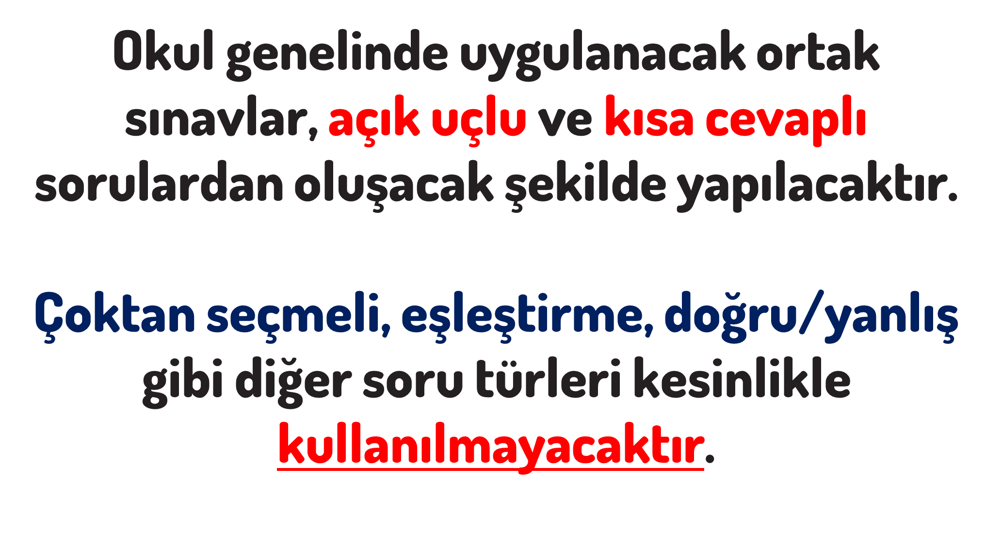

Slide 3


Slide 4
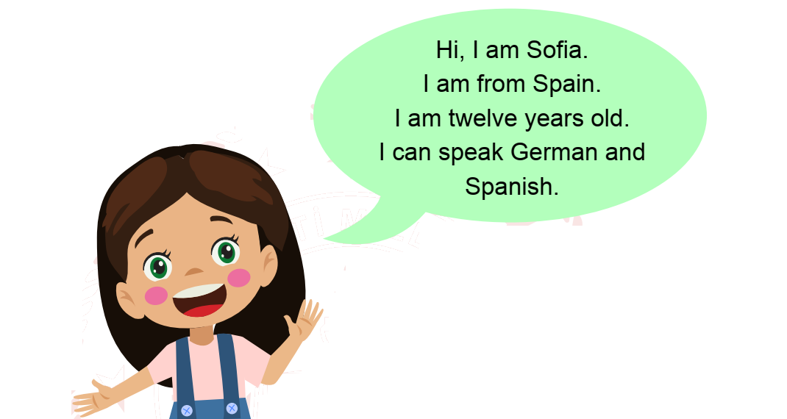
Sofia
12
German and Spanish
Spain

Slide 5
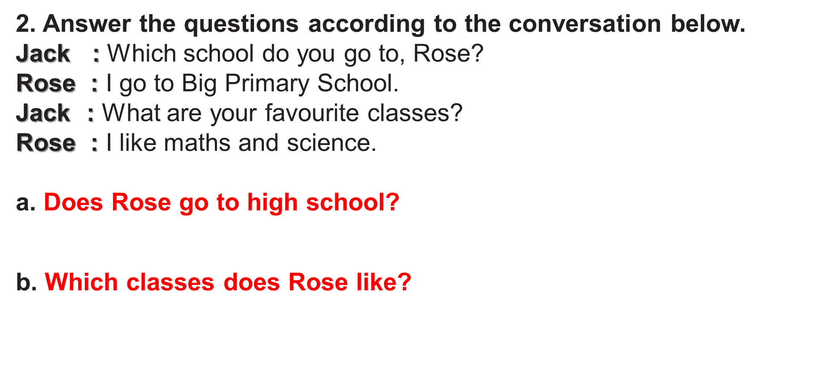
No, she doesn’t.
She likes Maths and Science

Slide 6
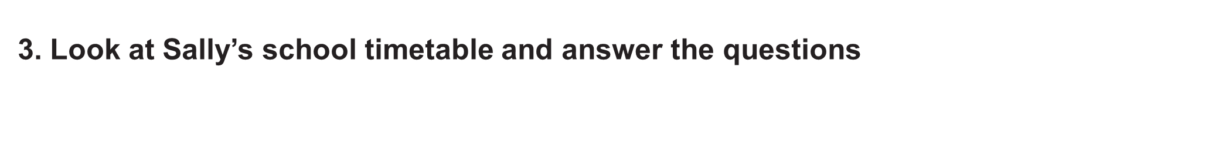
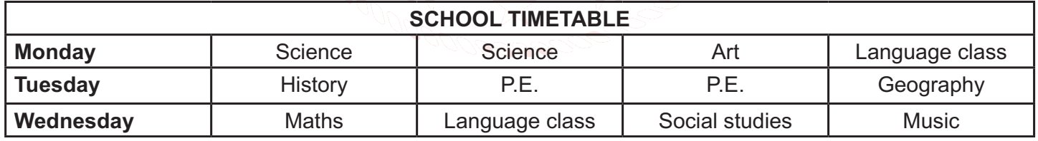
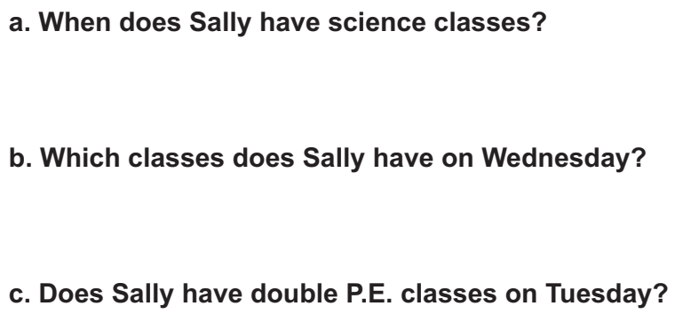
She has Science classes on Monday
She has Maths, Language class, Social Studies and Music.
Yes, she has.

Slide 7
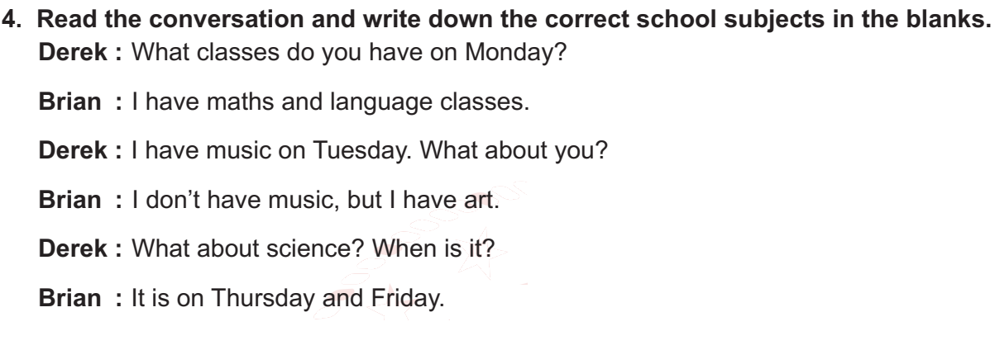
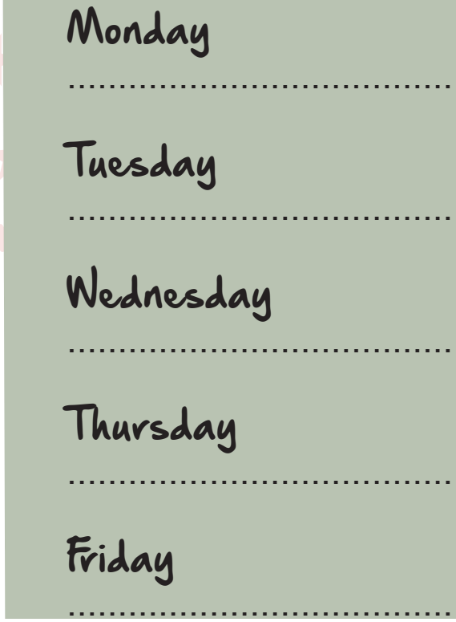
Maths, Language
Art (Derek – Music)
Science
Science

Slide 8
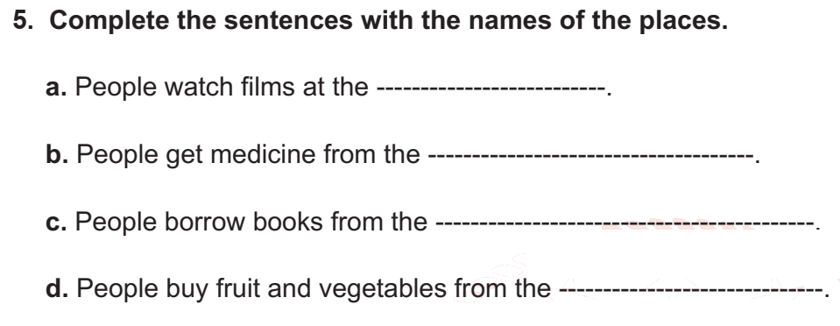
cinema
pharmacy
library
greengrocer
(market)

Slide 9
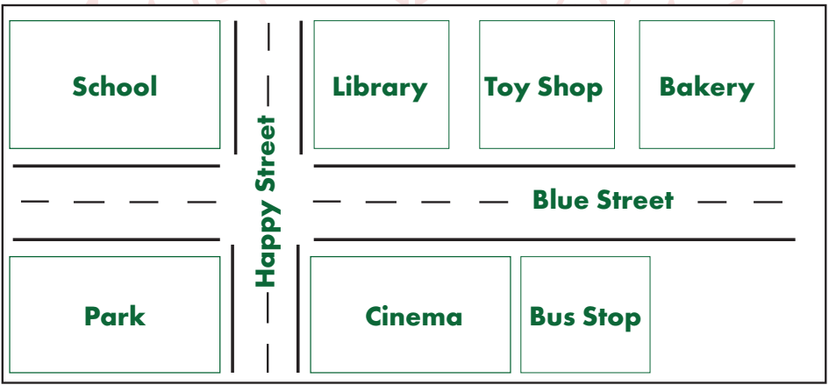
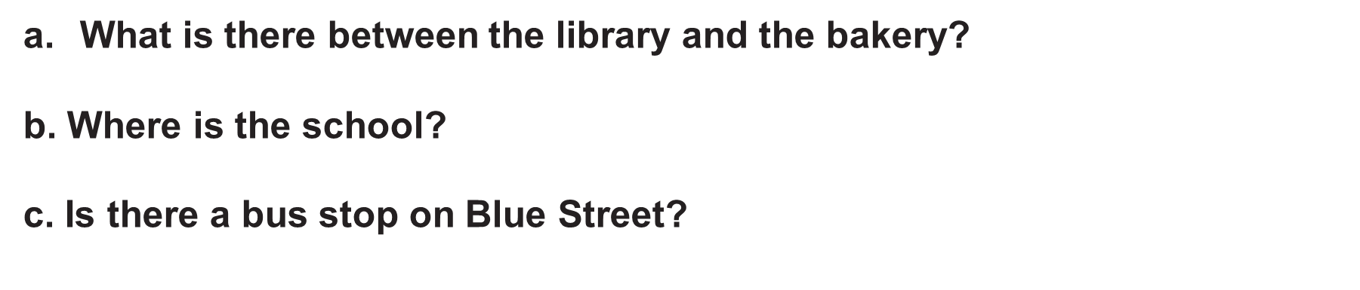
The toy shop is between the library and the bakery.
The school is opposite the park.
Yes, there is.

Slide 10


Slide 11
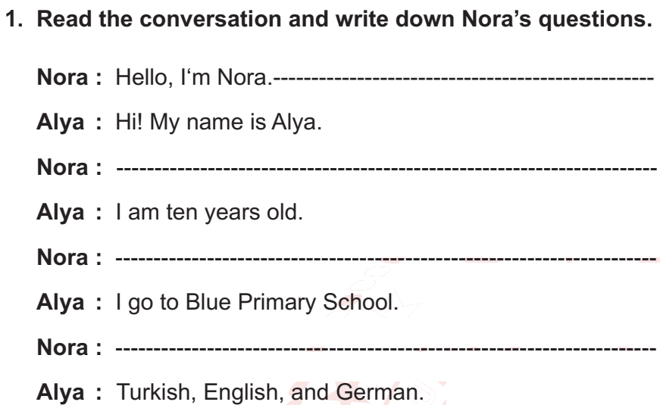
What is your name?
How old are you?
Where do you study?
Which languages do you speak?

Slide 12
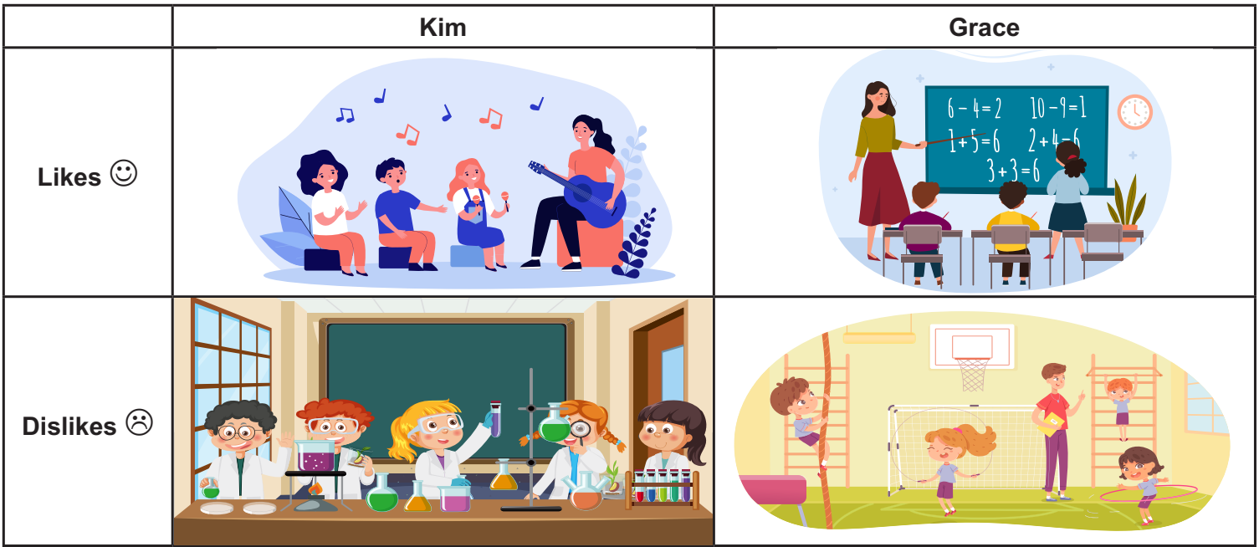
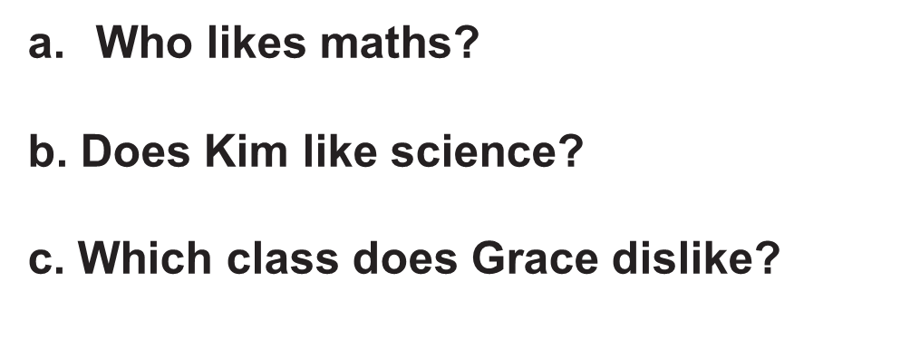

Grace likes Maths.
No, she doesn’t.
She dislikes P.E.
She likes Music.

Slide 13
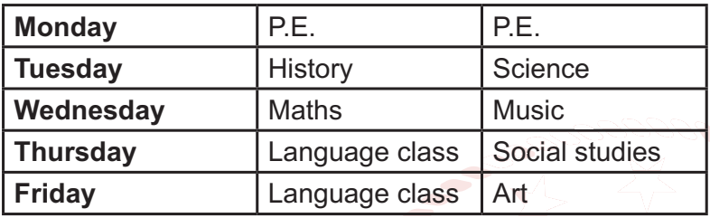
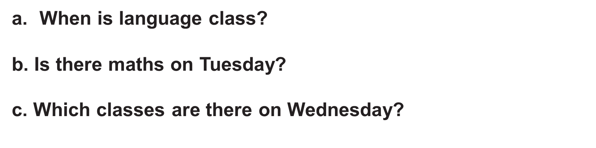
It is on Thursday and Friday.
No, there isn’t.
Maths and Music are on Wednesday.

Slide 14
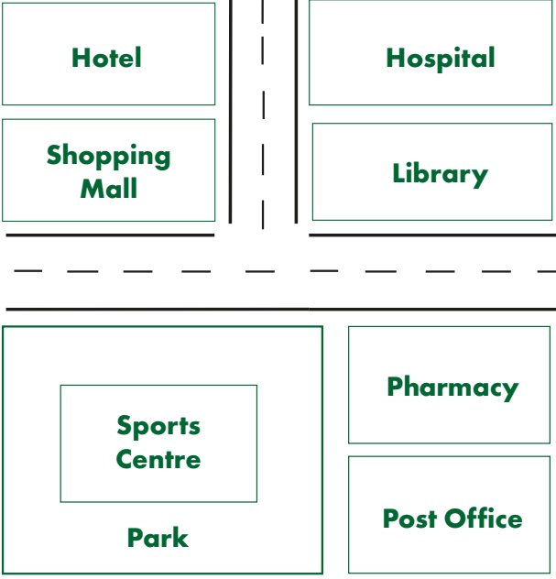
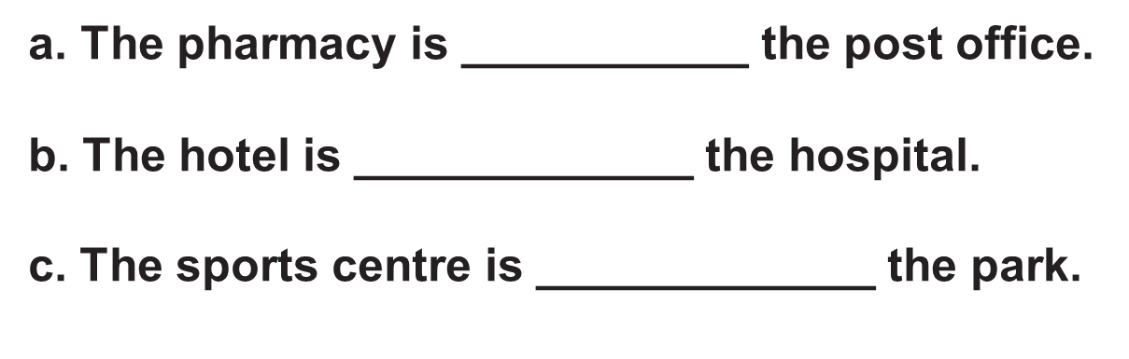
in front of
opposite
in front of

Slide 15
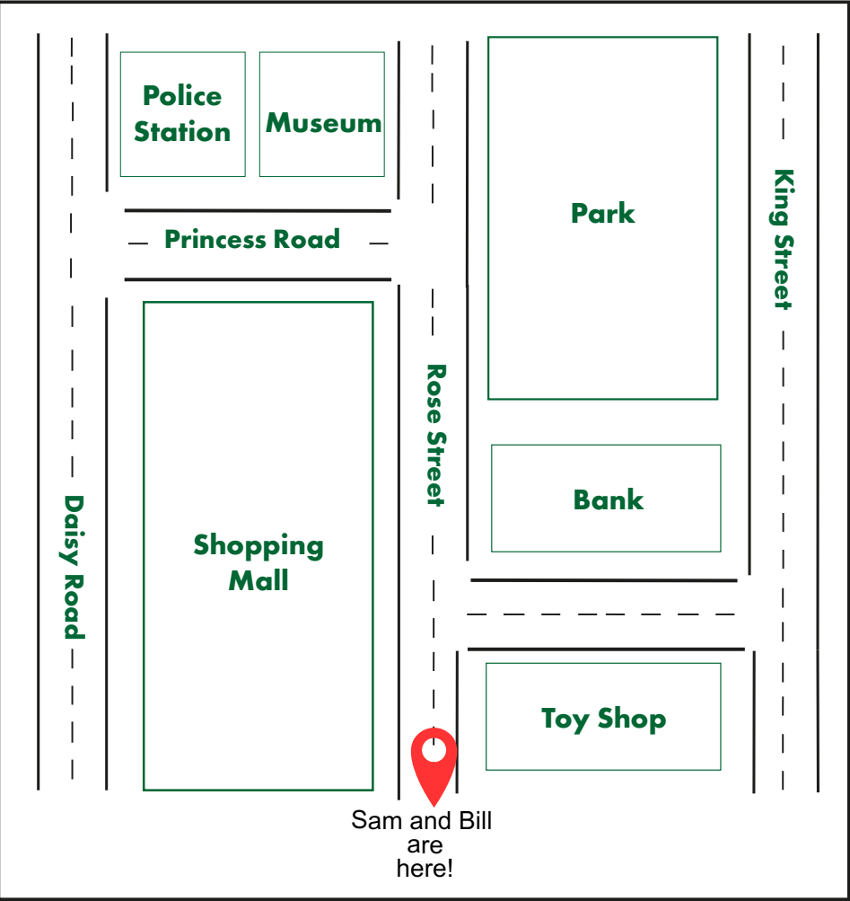
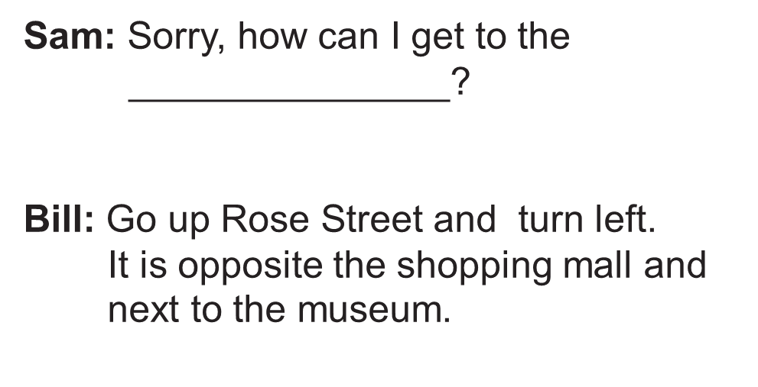
police station

